Slide 1

Notes:
Note to presenters:
Thank you for agreeing to be involved in communicating information about Forward Together in Hope – your role is vital in encouraging as many people as possible in the Diocese to become engaged in this review.
This PowerPoint presentation is designed for use in parishes and worshipping communities as part of the wider process of communicating Forward Together in Hope. It aims to bring together some of the key messages and information from the resource pack.
Please feel free to amend it to fit with the length of your meeting or to include specific local details. Also, if you need any clarification on any aspect, please don’t hesitate to contact a member of the Forward Together in Hope Team. We’d be happy to help.

Slide 2


Notes:
This slide presents the Forward Together in Hope logo and introduces the ‘Preparing the Way’ part of the journey.

Slide 3
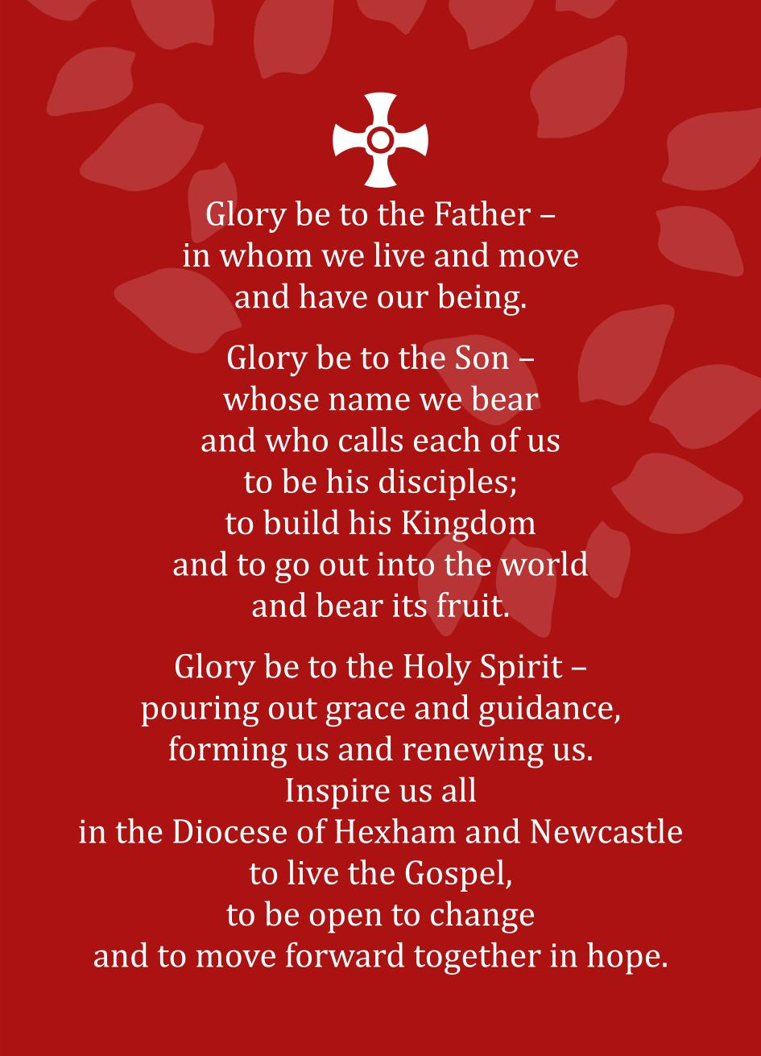
Notes:
The Forward Together in Hope Prayer
Bishop Séamus has asked that the Forward Together in Hope review process is firmly rooted in prayer. Whenever possible, please start this presentation with the Forward Together in Hope prayer shown in this slide.

Slide 4
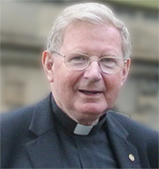
About Forward Together in Hope
‘The purpose of Forward Together in Hope is to help us discover how to be more committed disciples of Jesus Christ. It will also help us find a way of making best use of our resources in order to ensure we have a thriving and sustainable Catholic community into the future.’
Notes:
About Forward Together in Hope
The quote here is an extract from the Foreword by Bishop Séamus at the front of the ‘Preparing the Way’ Booklet where he leads and endorses the Forward Together in Hope process.
He sets out the purpose of Forward Together in Hope as primarily helping us to discover how to become more committed disciples of Jesus. He also highlights the task of seeking to make best use of our resources to ensure that Catholic communities are sustainable and thrive into the future.
The full ‘Foreword’ is on Page 3 of the ‘Preparing the Way’ document.

Slide 5

About Forward Together in Hope
Led by Bishop Séamus and the Diocesan Board
Built upon the foundations of our Diocesan Vision (2000)
Overseen by a Development Group with lay and clergy representation
Small core delivery team…
…but an ambition to involve everyone in our Diocese.
Notes:
About Forward Together in Hope
As well as the leadership from the Bishop, the Diocesan Board of Directors (which includes the Bishop, the Vicar General, the Episcopal Vicars and a number of lay Board Directors) is fully in support of the review process and takes a very keen interest in the progress that is being made.
The overall process hasn’t just started recently; in many ways it builds upon the work of Bishop Ambrose and others to identify a Diocesan Vision and to give thought to the Church in our Diocese into the future.
The work of Forward Together in Hope is overseen and steered by a small Development Group that meets frequently to support and challenge the delivery team. The group is chaired by The Vicar General, Fr Martin Stempczyk and members include Fr Jim O’Keefe, Kathryn Turner (Head of Spirituality Department), Kathleen Smith (Chief Operating Officer), Bill Dryden (Board Director).
The project team consists of Jim O’Keefe (Director), Tony Sacco (Development Officer) and Nancy Gash (Administrator). The team is also seeking to involve volunteers to support the work. Our ambition is for a wide understanding, engagement and involvement in the project from people right across the Diocese.

Slide 6


An Invitation
Forward Together in Hope is a personal invitation to everyone in our Diocese to take part in a journey of renewal.
Whether you are…
  Old or young – or somewhere in between
  At home, in education, employed or unemployed
  Clergy or lay person
  A regular church-goer or not
  Feeling included or feeling on the margins
  Or ‘none of the above’
  …you are invited to take part.
Notes:
An Invitation
This slide re-iterates the fact that each and every person in our Diocese is invited to take part in this Journey of Renewal – our Diocesan Review.
It is very important to get this message out so that people really do see that it is their chance – and their responsibility – to participate in the process. It isn’t just about the Bishop and the Board; it isn’t just about the Parish Priest or the Parish Pastoral Council. It is a process of consultation that everyone has a role in.
We are particularly keen to invite people who either can’t or don’t attend church regularly to feel part of the process too.
The key message here is – This involves you!

Slide 7

Some Principles
Firmly rooted in prayer
Clergy and lay people working together
Open, transparent and fair
Excellent communication
Clarity of decision-making
Inclusive and collaborative
Celebrating success
Sharing good practice
Notes:
Some Principles
These principles are fairly self-explanatory but they attempt to ‘set out the stall’ of how we wish to operate within Forward Together in Hope.
The message that we are trying to give is that while this process is far-reaching and might well be painful and difficult at times we want it to be as open and transparent as possible. We will aim to communicate well throughout the work and make clear the way decisions will be arrived at.
Part of the process of self-evaluation and reflection will help us identify what is working well and give us opportunities to celebrate success and share good practice.

Slide 8
Theological Context
Rooted in the Second Vatican Council
In Evangelii Gaudium (The Joy of the Gospel), Pope Francis invites each of us to a renewed encounter with Jesus.
He tells us ‘The Church is herself a missionary disciple; she needs to grow in her interpretation of the revealed word and in her understanding of truth’
‘I invite all Christians, everywhere, at this very moment, to a renewed personal encounter with
Jesus Christ’
Notes:
Theological Context
The Theological Context to Forward Together in Hope is set out in some detail in Section 2 on Page 6 of the ‘Preparing the Way’ Booklet.
This draws heavily from Pope Francis’ Apostolic Exhortation ‘Evangelii Gaudium’ (The Joy of the Gospel) that was published November 2013.

Slide 9

Theological Context
Pope Francis is inviting us to become open minded and imaginative in how we become missionary evangelists.
Key words to reflect on over the months ahead will be:
  Prayer
  Discipleship
  Viability
  Flourishing
  Diocese
Notes:
Theological Context
This slide highlights some of the key words that are important for us to reflect on during the Forward Together in Hope journey – namely Prayer, Discipleship, Viability, Flourishing and Diocese.
In other words… a commitment to prayer so that the Holy Spirit will lead us all to become disciples of Jesus in viable and flourishing communities in our Diocese.

Slide 10

The Case for Change
‘Diocesan Facts and Figures’ Supplement
Decreasing numbers of priests
Reducing attendance at Mass
Fairly static number of churches
Decreasing financial income
All of this provides a real opportunity to look at things differently
Notes:
The Case for Change
Note : The Case for Change is set out in Part 3 of the ‘Preparing the Way’ Document. In addition, the ‘Diocesan Facts and Figures’ Supplement contains more detailed graphs, statistics and financial information.
‘Diocesan Facts and Figures’ Supplement. – For those who might be interested in a more detailed picture of the changes in the Diocese this Supplement includes graphs relating to mass attendance, baptisms, confirmations, receptions, marriages numbers and age profile of priests. It also contains details of the financial changes over time.
Decreasing numbers of priests. - Between 1972 and 2014 the number of Diocesan priests (ie excluding those who are retired) has reduced from 333 to 106 – a decrease of over 67%.
Reducing attendance at Mass - Mass attendance has also fallen dramatically over the past few decades. Between 1981 and 2013 (the latest published statistics) the figures show a decrease from around 100,000 to less than 37,000, a reduction of over 63%.
Fairly static number of churches - There are currently 177 Diocesan churches in active use – a very similar number as in the 1970s
Decreasing financial income - For example, the income through offertory collections has reduced by around 20% over the last 5 years
A real opportunity to look at things differently
These statistics may appear startling, and show that we are already in the midst of major change but it is our intention that Forward Together in Hope will enable us to respond creatively to this. We can view it as an opportunity to look at things differently and discover new ways to build our communities and share our faith with others in the world.

Slide 11
The Case for Change
Notes:
The Case for Change
Diocesan Priests Graph
This graph indicates that between 1951 and 2014 the number of active or ‘non-retired’ Diocesan priests has fallen from 368 to 106. The number of retired priests has increased from 2 to 53. It is particularly significant that between 1972 and 2014 the number of active priests has reduced from 333 to 106 – a decrease of over 67%.
While it is not really possible to predict accurately how many active priests we will have in the Diocese in 2030, just 15 years from now, a best estimate is that we might have around 50. (See ‘Diocesan Facts and Figures’ Supplement for details of how we’ve estimated this).

Slide 12
The Case for Change
Notes:
The Case for Change
Average mass attendance
The graph reiterates that between 1981 and 2013 (the latest published statistics) the figures (as recorded in the Northern Catholic Calendar) show a decrease from 100,019 to less than 36,661, a reduction of over 63%.

Slide 13
The 3 Stages of the Journey
Preparing the Way (Autumn 2014-Spring 2015 )
  Developing liturgies and prayer resources
  Developing and distributing information leaflets
  Informing everyone about the approach through meetings, documents and a DVD
  Initial meetings and training for clergy and laity
  Bishop Séamus leads days of reflection
Notes:
The 3 Stages of the Journey
We have described the Forward Together in Hope process as three stages on a journey - Preparing the Way; Exploring the Way and Pointing the Way
The overall ‘map’ and timescales for the journey are shown in the diagram on the inside front cover of the ‘Preparing the Way’ Booklet.
Of course, a journey like this can never really end, but we hope that after 3 years we will have discovered some key indicators regarding the future of the Diocese and have started to put the new arrangements in place.
Over the next 3 slides some of the key elements of each of the stages of the journey are set out. Most of these are self-explanatory so only the key messages are highlighted here:
a) Preparing the Way
This is very much a stage of everyone finding out about Forward Together in Hope and preparing for the journey ahead.
The key aspect at parish level is to put in place a range of communication methods to get people geared up and involved.
More details of how the preparation might take place is given later on the slide titled ‘How can we Prepare?’

Slide 14

The 3 Stages of the Journey
Exploring the Way (Spring 2015-Summer 2016)
  Prayer and liturgies across the Diocese
  Providing unique data to each parish at Pentecost
  Extensive consultation and self-evaluation process in each worshipping community
  Return of completed self-evaluation questionnaire and recommendations by Advent
  Detailed analysis and validation of responses
  Clarification meetings and on-going discussions
Notes:
The 3 Stages of the Journey
b) Exploring the Way
The work at parish level really starts in earnest in May 2015 – around Pentecost. Every worshipping community will receive a detailed self-evaluation questionnaire to be completed between then and the end of November.
They will also receive a pack of data with details about their community extracted from information held centrally by the Diocese.
Between Pentecost and Advent, each worshipping community will look in detail at how best it can flourish into the future. The invitation to every community is to be both painstaking and honest in its approach to a self-evaluation questionnaire.

Slide 15

The 3 Stages of the Journey
Pointing the Way
  Prayer and liturgies across the Diocese
  Consideration of recommendations by Diocesan-wide group of clergy and laity
  Information and analysis made available to Bishop Séamus to take decisions about the future
  Communicating these decisions and indicating the way forward for everyone
  Supporting parishes in moving to the new arrangements
Notes:
The 3 Stages of the Journey
c) Pointing the Way
One of the key aspects of the Forward Together in Hope process is that of openness and transparency. To help ensure that this is the case it is proposed that once all information is collected the results will be looked at carefully by a wide-ranging group of priests and people so that their views and perspectives can help finalise the indications, pointers and recommendations for the Bishop.
The diagram and narrative on Page 18 of the ‘Preparing the Way’ document set out more details.

Slide 16

How can we prepare?
What structures will you put in place to carry out the self-evaluation?
How will you use the ‘Preparing the Way’ resources including the liturgy and spirituality resources?
How can you ensure that particular groups, e.g. the housebound and young people, are fully involved?
How might you engage with less regular worshippers?
Perhaps parishioners could start to look at the 10 questionnaire headings and begin to assemble information.
Notes:
How Can we Prepare?
The information in this slide is an extract from the set of questions and suggestions on Page 17 of the Preparing the Way document. The full list is…
What structures will you put in place to carry out the self-evaluation process and the completion of the questionnaire? Are these existing arrangements or will new ones be required?
How will you use these ‘Preparing the Way’ resources (including the DVD and PowerPoint presentation) to help prepare parishioners for the process?
In what ways will you utilise the liturgy and spirituality resources to put in place a prayerful foundation to Forward Together in Hope?
How can you ensure that the hopes and ideas of those who are housebound are fully incorporated?
How might you ensure that the views, hopes and aspirations of young people are included in the whole process?
Ideally, every parishioner, both regular worshippers and those who have a more ‘casual’ relationship with the community, can be involved in this whole exercise. How can the more regular groups – Parish Council, Finance Committee, SVP, coffee groups etc. explore ways of engaging with less regular worshippers?
The Forward Together in Hope prayer could be said at daily mass, or weekend masses, or at the beginning of the regular meetings.
Perhaps parishioners working together could start to look at the 10 questionnaire headings and begin to assemble information around the various topics. The process does not need to be rushed, but it might help the whole community to address the issues more carefully once the questionnaire arrives.

Slide 17

Questionnaire Headings
Education and Continuing Formation
Active Involvement of People
Worship and Spiritual Life
Geographic Distance
Christian Faithful
Young People
Leadership
Outreach
Finances
Facilities
Notes:
Questionnaire Headings
The sections of the self-evaluation questionnaire will have the headings shown in this slide. They are presented here randomly – and around the tree – so as not to suggest that any one area is more important than another.
On pages 14-17 of the ‘Preparing the Way’ document there is more detailed information about each area.
Parishes should be encouraged to start to think through each of the headings in the context of its own situation.

Slide 18
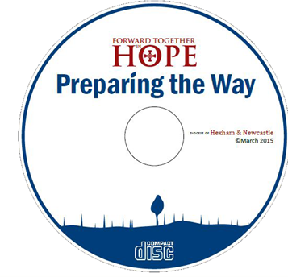
Preparing the Way Resources
8 minute DVD
Preparing the Way booklet
Diocesan Facts and Figures
Our Story So Far – A Brief History of the Church in this Area
Prayer and Liturgy Resources and Ideas
All items also on CD and website at: www.hope.rcdhn.org.uk
Notes:
Preparing the Way Resources
At each stage of the journey, resources will be made available to support parishes. A ring-binder file has been made available to all priests and lay representatives containing the initial resources and as a place to store subsequent information about Forward Together in Hope.
A copy of the DVD and the CD containing electronic versions of the documents are being made available to all Catholic schools in the Diocese.
The Preparing the Way stage includes all of the items shown on this slide and the items are illustrated across the next two slides.
Most documents will also be made available on the Diocesan website at www.hope.rcdhn.org.uk

Slide 19

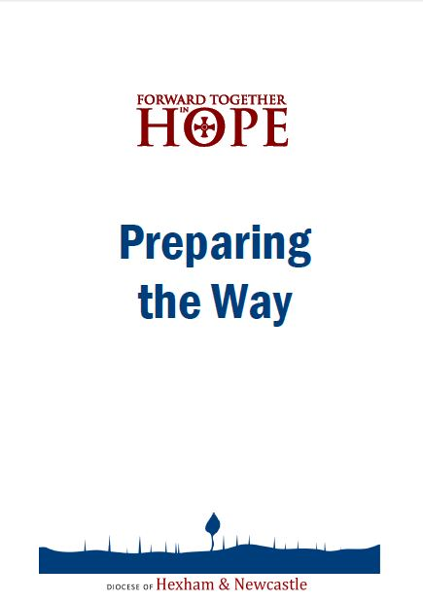


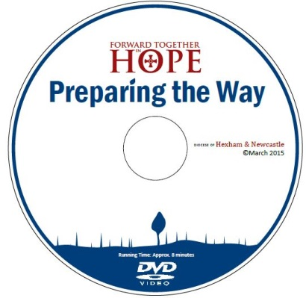
Preparing the Way Resources
Notes:
Preparing the Way Resources
This slide and the next show the range of materials initially included in the resource pack. (Note: the CD includes other items also)
Items include:
‘Preparing the Way’ - giving an overview of the Forward Together in Hope journey and the reasons why we are undertaking it.
‘Our Story So Far’, a brief history of the church in the area, noting that we have never been static; we have constantly adapted.
A ‘Diocesan Facts and Figures’ Supplement.
Prayer and liturgy resources to support your preparations.
This PowerPoint presentation.
A CD containing all of the above items and additional materials electronically.
A short (8 minute) DVD with key messages about Forward Together in Hope.

Slide 20





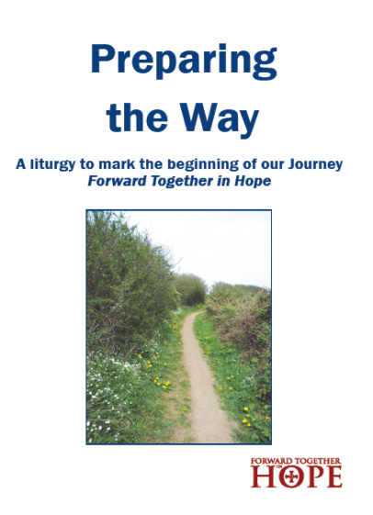
Preparing the Way Resources
Notes:
Preparing the Way Resources
A number of Prayer and Liturgy resources are also available in the pack – and even more items are available on the CD.
The ‘Prayer and Liturgy Resources’ A4 document provides an overview of the items.

Slide 21

Information and Contacts
Ring binders in each parish
  Documents, CD and DVD
Lay contact in each parish to help communicate about the process
All resources and latest news on the website www.hope.rcdhn.org.uk
Email: hope@diocesehn.org.uk
Notes:
Information and Contacts
The importance of good information and communication throughout the process is vital and this slide is a reminder of the website and e-mail contacts for the Forward Together in Hope team.

Slide 22

I firmly believe that the Holy Spirit is with us, giving us the courage we need to move forward together in hope.
Notes:
And finally…
This slide shows the front of the Forward Together in Hope prayer card and highlights Bishop Seamus’ belief that we are being guided by the Holy Spirit throughout the Forward Together in Hope journey.

